Slide 1
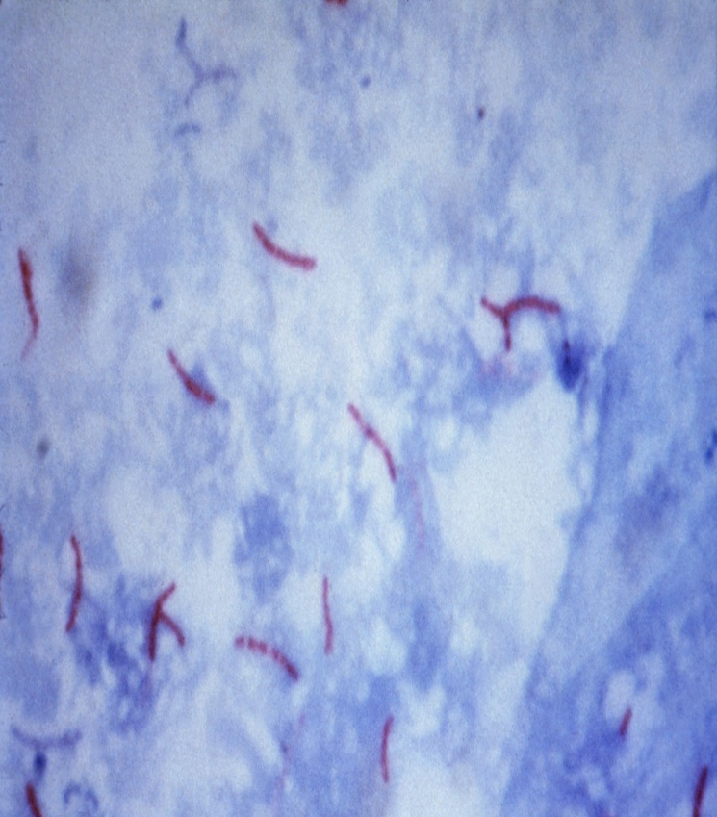
Mycobacterium
Mycobacteria cover the range from saprophytes to opportunists to obligate pathogens. All members of the genus are aerobic, acid- fast, non-spore forming, non-motile, (G+ rods). They are catalase +, many produce pigments, & most have simple growth requirements. Slowly growing mycobacteria require 7-14 days (or longer in case of low titer inoculum, e.g. M. tuberculosis require 6 weeks from sputum). The generation time of M.tuberculosis is 300 minutes compared to E. coli, 20 minutes & C.diphtheria 60 minutes.
Acid fastness refers to the ability of mycobacterial cells to bind phenol-based dyes, e.g. Carbol-fucchin in 5% phenol, typically when heated with staining. The dye is retained when the smear is subsequently decolorized by acid-alcohol.
Complex lipid in the mycobacterial cell wall include the mycolic acid. Acid fastness related to

Slide 2
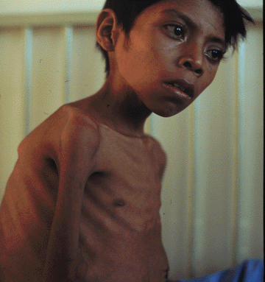
Mycobacterium
The presence of peptidoglycan & glycopeptide. This cell wall composition is also responsible for resistance to drying, extremes of pH, & other environmental stresses. The complex lipid-rich cell wall also protects the organism in the phagosome, & probably play a role in mycobacterial survival in macrophages. Furthermore, components of the cell wall are immunostimulatory & are the basis for adjuvants (Freund’s complete). Some mycobacteria are major pathogen of domestic animals, whereas others are encountered only occasionally.

Slide 3
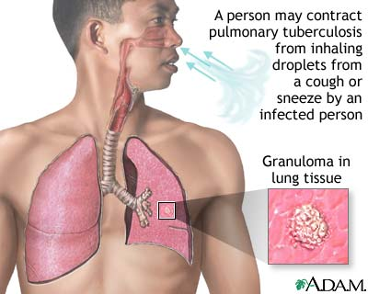
Mycobacterium tuberculosis complex
Members of the M.TB complex differe widely in host range, phenotype, & virulence, despite 99.9% similarity in nucleotide sequence. They are assumed to be derived from common ancestory, yet some M.TB., M.africanum & M. canettii are almost exclusively human pathogens, whereas others M.bovis are more cosmopolitan in host range.
Infection by M.TB. Is primarily a problem in human & subhuman primates, but dogs, birds, swine & many other species are susceptible to human TB. Feline cutaneous TB is associated with infection by M.TB or M. bovis & present as multiple ulcers & abscesses in the form of pyogranulomatous dermatitis with caseous necrosis.
TB made a major impact on human health worldwide, about 2 billion people were infected, with 8 million new cases/year. TB causes more than 5% of the infant death, nearly 20% of adult death & perhaps more than 25% of avoidable deaths.
The increase in the prevalence was encouraged by crowded communities & prisons, increase in drug abusers & patients with AIDS (TB is the leading killer of HIV/AIDS patients), especially in developing countries. Drug resistance had been a problem since the early days of streptomycin use, & this become worse by emergence of multidrug resistance (MDR-M.TB). The case fatality rate of untreated TB may be as high as 50%.

Slide 4
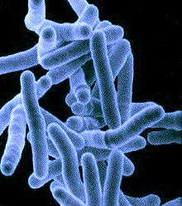
Pathogenesis
M.TB can infect any area in the body, including bones, joints, liver, spleen, GIT, & brain. In these sites its preferred residence is within cells of RES. Transmission is usually by airborne route (droplets nuclei < 5 microns). Infection can occur by other routes, ingestion of M.TB can lead to infection through cervical or mesenteric LNs. Individuals developing TB experience fever, cough (often with bloody sputum), malaise & anorexia with progressive irreversible lung destruction.
Regardless the route of infection, M.TB phagocytosed by macrophages, probably following complement-mediated opsonization. Survival & multiplication of M.TB in phagocytes is the key factor in development of disease. Phagosome-lysosome fusion occurs, but the organism either escape to the cytoplasm or simply multiply within the phagolysosome & causing it to burst. This is related to the ability of M.TB to prevent acidification of the phagosome, which decreases the killing capacity of phagocytes.

Slide 5
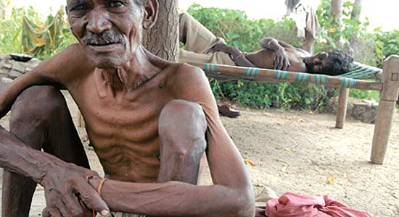
Pathogenesis
The ability to mount a rapid & effective activated macrophage response determine the outcome of infection by M.TB. The immune system effectively contains the infection, & < 10% of those infected develop disease. In healthy adults infected with low numbers of M.TB , the immune system stops the infection before lung damage, & although the person becomes Tuberculin skin test (TST)positive, symptomatic TB does not develop. In many cases, M.TB is not eradicated but contained in discrete lesions (old TB), & disease may develop through reactivation when immunity is weakened.
The immune response to M.TB is T-cell dependent, but the immune mechanisms of acquired resistance are associated with activation of macrophages by cytokines & direct cytolytic activity. The initial interaction between M.TB & macrophages elicits a T-helper (CD4) cell response. The Th2 subset mediate antibody production that has no role in protection or recovery from infection.

Slide 6
Pathogenesis
The main contribution of CD4 T cells is by those of subset Th1, which releases INF- γ, stimulating activation of macrophages, which then ingest & kill mycobacteria. INF-γ also stimulates endothelial binding & emigration of T cells to the affected area. If the immune response is delayed or nonexistent, viable M.TB may reach the regional LNs & through the lymphatic & bloodstream to distant tissues, nearly always within the macrophages. Most bacteria, however, are contained locally in a specific type of granuloma called tubercle. Layers of T cells, neutrophils, macrophages, multinucleated giant cells & a thick fibrin coat form around growing foci of necrosis. Calcified tubercles appears as lesions in chest X-ray. During reactivation type of TB, these foci are broken down & releasing their contents with the viable bacteria, which appear as bloody sputum. Mechanisms of tissue destruction include both local & systemic inflammatory response. Lung damage may also result from the action of INF-α which accumulate in response to Mycobacterial cell wall components.

Slide 7
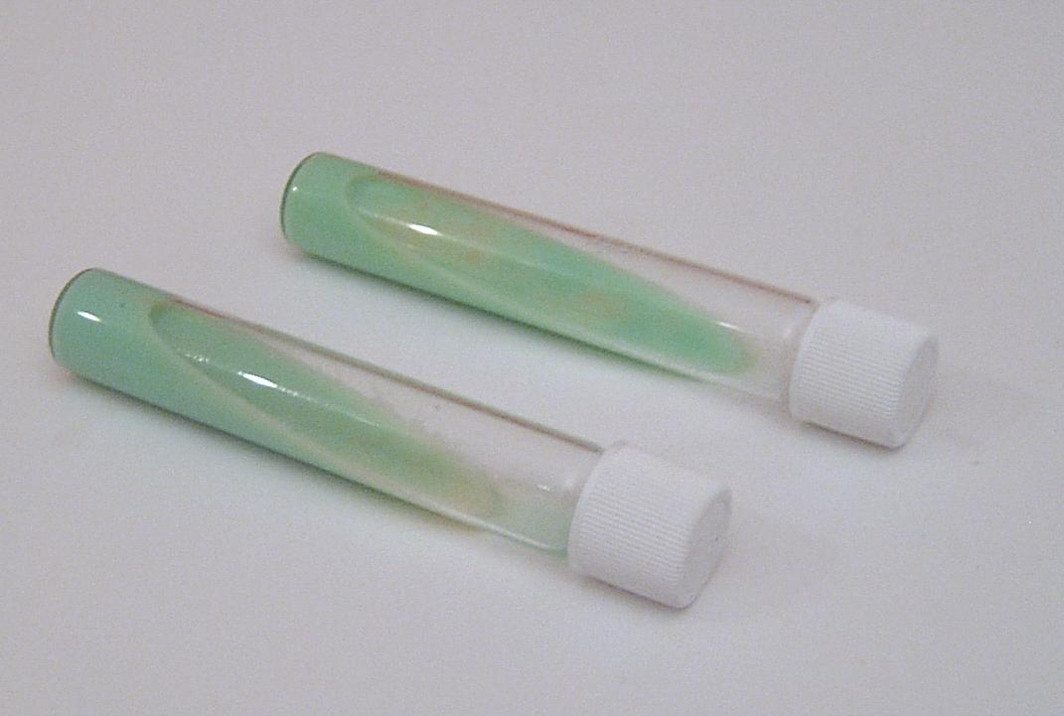
Laboratory diagnosis of TB
Microscopical examination of AFB in sputum smear. Fluorochrome stain (Auramine O-acridine organe) is also helpful, which is more sensitive than traditional Zeil Nelseen stain (AFB).
Bacteriological culture of specimens is important to confirm the etiology & drug sensitivity testing. Culture is often on egg-based medium (Lowenstein-Jensen media), agar-egg based medium (Harrold’s medium) or non-egg medium (Middlebrook’s medium), incubated at 37 C for 6 weeks.
For rapid surveillance, the intradermal tuberculin skin test is used (Tuberculin is a crude extract of the M.TB cell wall) or purified protein derivative (PPD) injected I/D (5-10 Tuberculin units). if erythema & induration follow after 48-72 hrs, the test is positive. Conversion to positive occur within 1 month of exposure to M.TB & is associated with immunization. TST is mediated by sensitized CD4 T-helper cells.

Slide 8
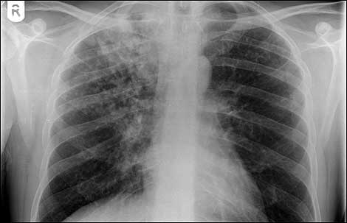
Laboratory diagnosis of TB
Many with active TB, especially disseminated disease or early in active Pulmonary TB, convert to TST negative.
Serological test for detection of anti-M.TB antibodies are of limited value in the diagnosis of TB.
4. Determination of the levels of INF- γ may be helpful.
5. ESR: Erythrocyte sedimentation rate
Immunization against human TB:
Immunization is widely practiced in many countries through the use of the BCG. It is based on the attenuated Bacillus of Calmette & Guerin stain of M.bovis given I/M. The protection confirmed by this vaccine is often questionable.
Treatment of TB:
Classical regimen:
DOTS (Directly Observed Therapy, Short course). Streptomycin, isoniazid (INH), Rifampicin, Ethambutol, Pyrazinamide.
Dots plus strategy: Ciprofloxacin, azethromycin

Slide 9
M. Africanum & M. bovis
M. Africanum is another member of Mycobacterium tuberculosis complex & a cause of tuberculosis.
M.bovis: is the best known as the cause of tuberculosis in cattle & other ruminants, but it also infects human, swine, & other animals. In humans, M.bovis associated disease often begins with infection of cervical & mesenteric LNs with systemic metatases that often affect joints & bones. Infection occurs in childhood by consumption of milk from tuberculosis cows. Vaccination against bovine tuberculosis could be important in areas where M.bovis infection persist.
The identical clinical disease caused by both in humans suggest that many virulence factors of M. bovis & M.TB. Coincide. Virulence of M. bovis in part in its cell wall lipids that protect the organism from effect of phagocytosis & glycolipid that mediate the host’s granuloma & enhance intracellular survival.

Slide 10
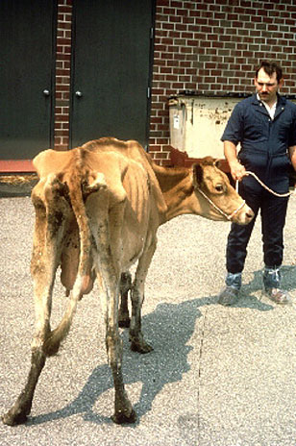
M. bovis M.avium
Infection in cattle is usually via respiratory & intestinal tract; local multiplication, survival in phagocytes & transport to regional LNs is followed by entry to systemic circulation. Infection may continue to disseminate by erosion of bronchi, blood vessels or visceral organs. T cell mediated reaction may participate in tissue damage.
M. Avium is divided into subspecies, M.paratuberculosis & M.silvaticum. M. intracellulare is commonly grouped with M. avium (M. avium-intracellulare complex), but it is genetically distinct species. These organisms are found widely in soil & water. Both causes disease in animals & humans, & M.avium is a predominant isolate from patients with AIDS & from infection in swine.
M. Avium spp paratuberculosis is the causative agent of Johnes disease or paratuberculosis. It is a severe form of enteritis, which has major

Slide 11
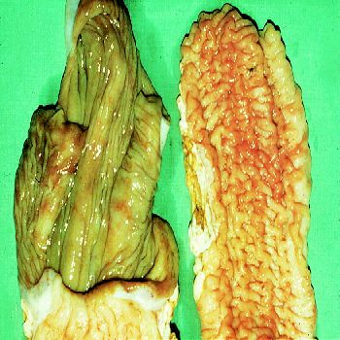
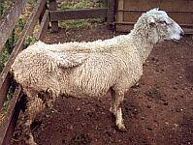
Johnes disease in sheep & intestinal lesion

Slide 12
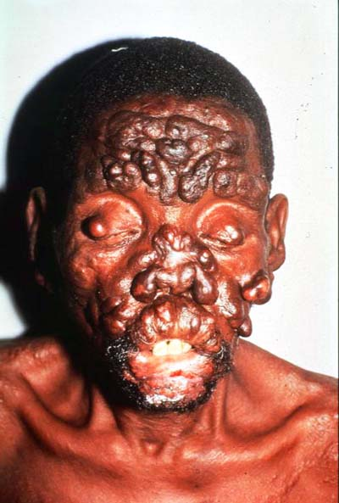
M.leprae
Economic impact on the dairy industry worldwide. The organism can infects many wild & domestic ruminants.
Neonatal & juvenile animals are the most predominant risk group, and the source of infection by M.avium paratuberculosis is most commonly contaminated milk or the environment.
M. Avium paratuberculosis interacts with mucosa-associated lymphoid tissues and has a particular tropism for M cells in ileal Peyer’s patches, & intramacrophage is then the hallmark of M.avium spp paratuberculosis.
M. leprae:
Approximately 11 million cases of leprosy in the world are found mainly in the tropics. The disease occurs in two forms; the less serious of which is tuberculous leprosy, the organism are well contained in granulomatous lesions and progression result in relatively little disfigurement.

Slide 13
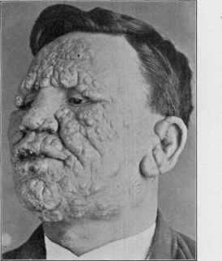
M. kansasii
Lepromatous leprosy, on the other hand, is more serious, with disfigurement resulting from the proliferation of nodular swelling in tissues. Fibrosis of peripheral nerves results in anaesthesia, which followed by spontaneous amputation of toes and fingers.
M.Kansasii:
is an opportunistic pathogen of human causing mainly respiratory infection and lymphadenitis in individuals with predisposing immunosuppressive problems. It has been rarely associated with mesenteric lymphadenitis in calves and occasionally with other infections in cattle. M.kansasii has also been isolated from bronchial LNs of monkeys

